Slide 1
Software Requirements

Slide 2
Functional Requirements
Non-Functional Requirements

Slide 3
What goes on in the mind?

Slide 4
Software Requirements
The software requirements are description of features and functionalities of the target system.
Requirements convey the expectations of users from the software product.
The requirements can be obvious or hidden, known or unknown, expected or unexpected from client’s point of view.

Slide 5
Requirement Engineering
The process to gather the software requirements from client, analyze and document them is known as requirement engineering.
The goal of requirement engineering is to develop and maintain sophisticated and descriptive ‘System Requirements Specification’ document

Slide 6
Requirement Engineering Process
It is a four step process, which includes –
Feasibility Study
Requirement Gathering
Software Requirement Specification
Software Requirement Validation

Slide 7
Feasibility study
When the client approaches the organization for getting the desired product developed, it comes up with rough idea about what all functions the software must perform and which all features are expected from the software.
Referencing to this information, the analysts does a detailed study about whether the desired system and its functionality are feasible to develop.
This feasibility study is focused towards goal of the organization.
This study analyzes whether the software product can be practically materialized in terms of implementation, contribution of project to organization, cost constraints and as per values and objectives of the organization.
It explores technical aspects of the project and product such as usability, maintainability, productivity and integration ability.

Slide 8
In short
Feasibility Study reflect:
Is this project really worth doing
Can we do this project
Will the organization accept this if we go ahead
Based on that, we practice Three types of Feasibility Study
Technical Feasibility: Can we build it?
Economic Feasibility: Should we build it?
Organizational Feasibility: If we build it, will they come?

Slide 9
Requirement Gathering
If the feasibility report is positive towards undertaking the project, next phase starts with gathering requirements from the user.
Analysts and engineers communicate with the client and end-users to know their ideas on what the software should provide and which features they want the software to include.

Slide 10
Software Requirement Specification
SRS is a document created by system analyst after the requirements are collected from various stakeholders.
SRS defines how the intended software will interact with hardware, external interfaces, speed of operation, response time of system, portability of software across various platforms, maintainability, speed of recovery after crashing, Security, Quality, Limitations etc.
The requirements received from client are written in natural language. It is the responsibility of system analyst to document the requirements in technical language so that they can be comprehended and useful by the software development team.

Slide 11
Software requirements speciation
A software requirements specification (SRS) is a detailed description of a software system to be developed with its functional and non-functional requirements.
The SRS is developed based the agreement between customer and contractors.
A software requirements specification (SRS) is a document that captures complete description about how the system is expected to perform.
It is usually signed off at the end of requirements engineering phase.

Slide 12
SRS should come up with following features:
User Requirements are expressed in natural language.
Technical requirements are expressed in structured language, which is used inside the organization.
Design description should be written in Pseudo code.
Format of Forms and GUI screen prints.
Conditional and mathematical notations for DFDs etc.

Slide 13
Software Requirement Validation
After requirement specifications are developed, the requirements mentioned in this document are validated.
User might ask for illegal, impractical solution or experts may interpret the requirements incorrectly.
This results in huge increase in cost if not nipped in the bud.
Requirements can be checked against following conditions:
If they can be practically implemented
If they are valid and as per functionality and domain of software
If there are any ambiguities
If they are complete
If they can be demonstrated

Slide 14
Types of requirement
User requirements
Statements in natural language plus diagrams of the services the system provides and its operational constraints. Written for customers
System requirements
A structured document setting out detailed descriptions of the system services. Written as a contract between client and contractor
Software specification
A detailed software description which can serve as a basis for a design or implementation. Written for developers

Slide 15
Requirements readers

Slide 16
Continue
We should try to understand what sort of requirements may arise in the requirement elicitation phase and what kinds of requirements are expected from the software system.
Broadly software requirements should be categorized in two categories:
Functional Requirements
Non-Functional Requirements
User Interface requirements

Slide 17
Requirements are categorized logically
Must Have : Software cannot be said operational without them.
Should have : Enhancing the functionality of software.
Could have : Software can still properly function with these requirements.
Wish list : These requirements do not map to any objectives of software.
While developing software,
‘Must have’ must be implemented,
‘Should have’ is a matter of debate with stakeholders and negation, whereas
‘could have’ and ‘wish list’ can be kept for software updates.

Slide 18
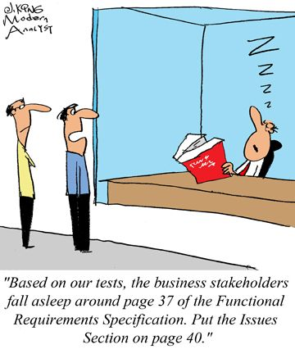
Functional Requirements

Slide 19
Functional requirements
Describe functionality or system services
Depend on the type of software, expected users and the type of system where the software is used
Functional user requirements may be high-level statements of what the system should do but functional system requirements should describe the system services in detail

Slide 20
Functional requirements
Requirements, which are related to functional aspect of software fall into this category.
They define functions and functionality within and from the software system.
Examples -
Search option given to user to search from various invoices.
User should be able to mail any report to management.
Users can be divided into groups and groups can be given separate rights.
Should comply business rules and administrative functions.
Software is developed keeping downward compatibility intact.

Slide 21
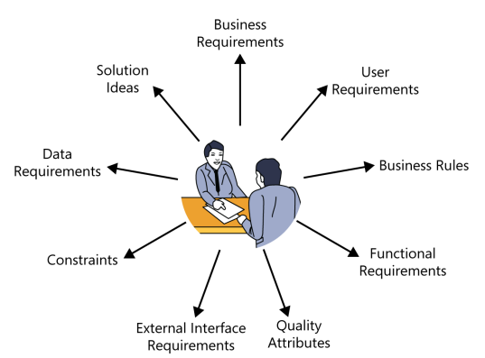
Classifying customer input

Slide 22

Non-Functional Requirements

Slide 23
Non-Functional requirements
Non-functional requirements define the overall qualities or attributes of the resulting system
Non-functional requirements place restrictions on the product being developed, the development process, and specify external constraints that the product must meet.
Examples of NFR include safety, security, usability, reliability and performance requirements.
Project management issues (costs, time, schedule) are often considered as non-functional requirements as well

Slide 24
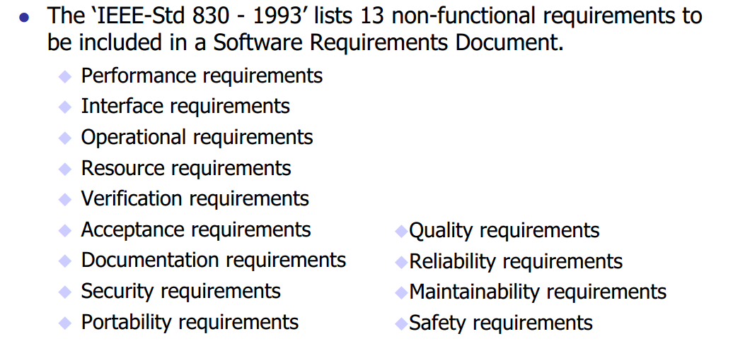
IEEE NRF

Slide 25
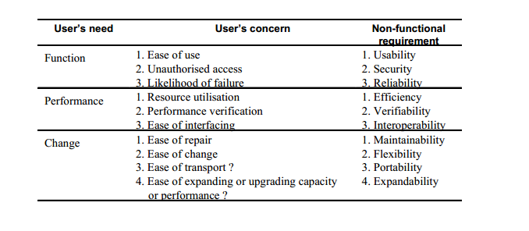
Relationships between user needs, concerns and NFRs

Slide 26
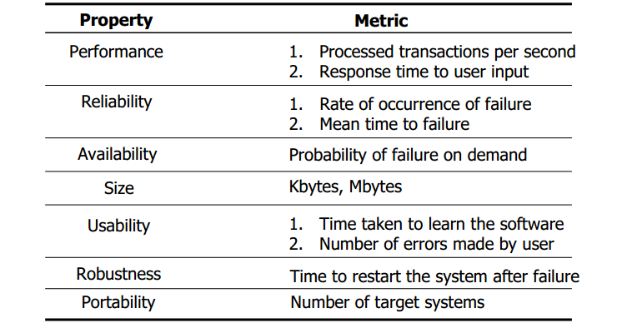
Examples of measurable metrics for Non-functional requirements

Slide 27
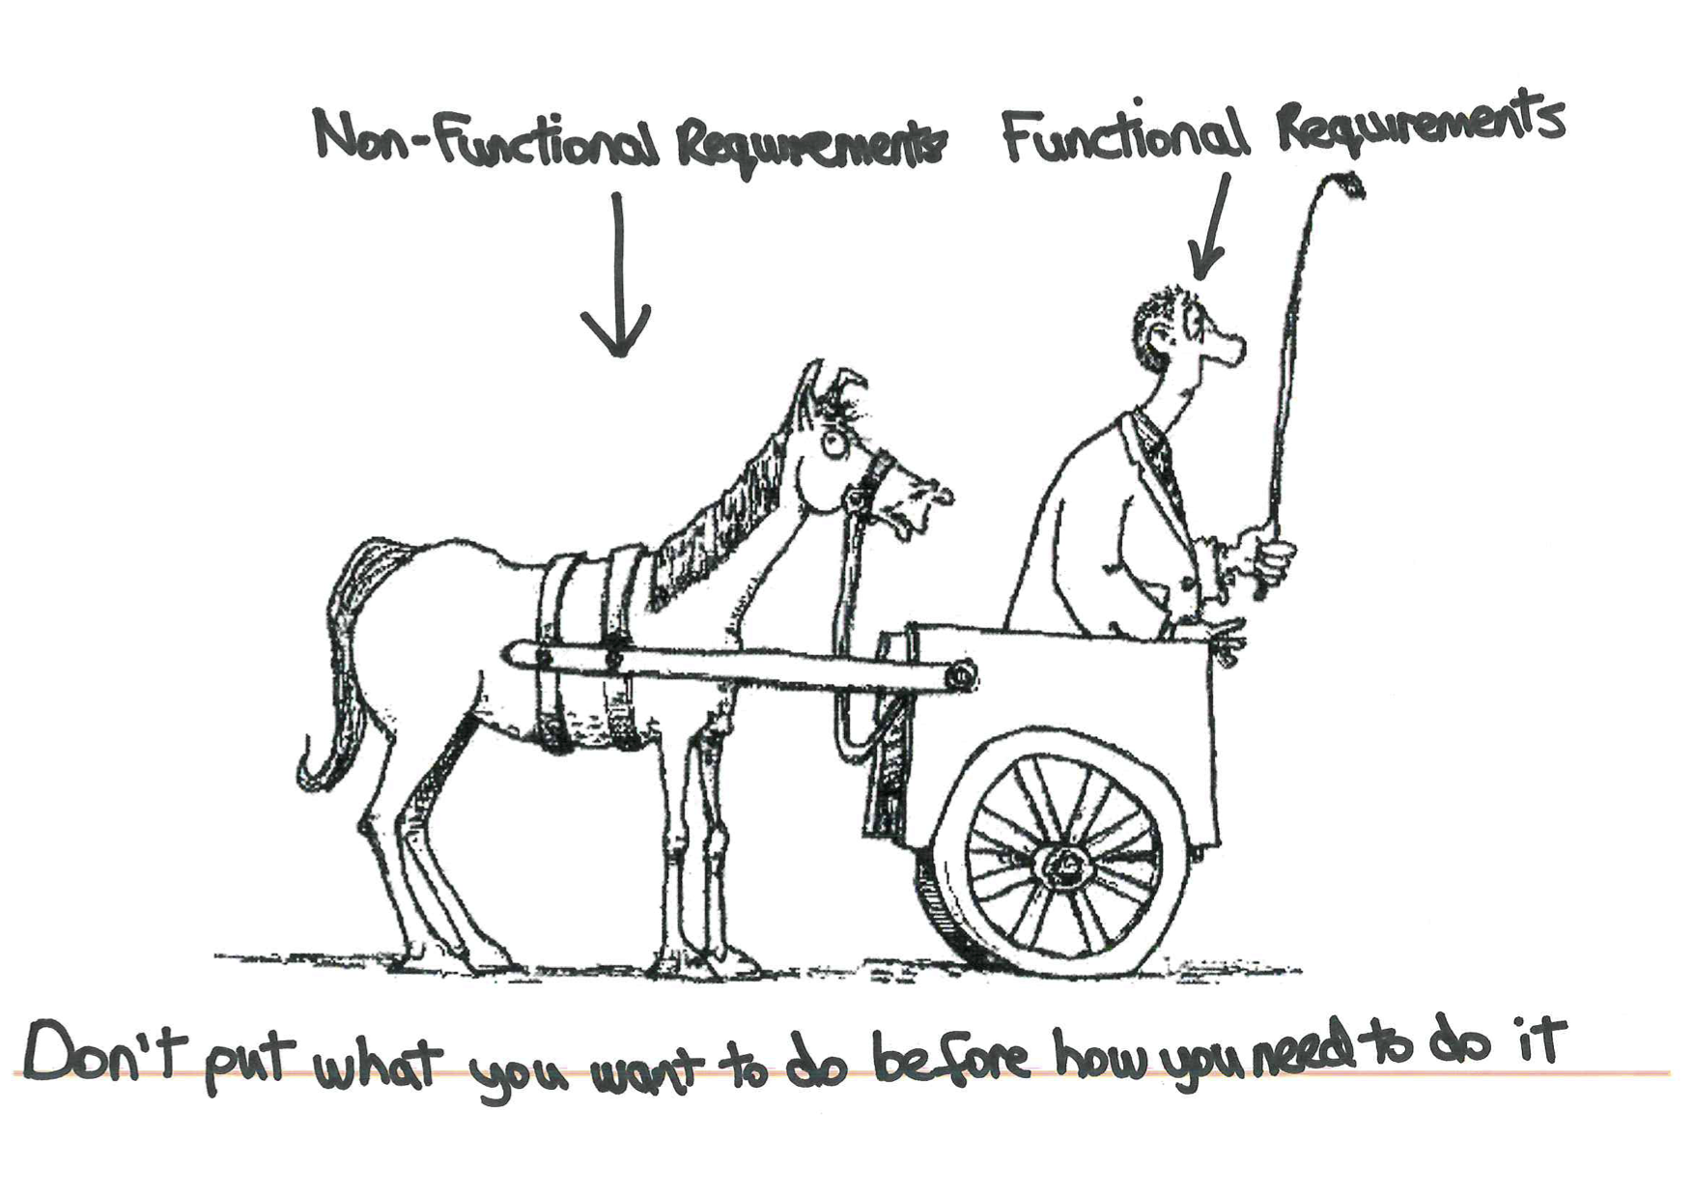

Slide 28
User Interface requirements
UI is an important part of any software or hardware or hybrid system.
A software is widely accepted if it is -
easy to operate
quick in response
effectively handling operational errors
providing simple yet consistent user interface

